Slide 1
The Final Battle of Neighborhoods-Cities of Toronto and Chicago
A case study of Application of Foursquare and Machine Learning algorithms
by
Marcel I Ngwueke

Slide 2
Introduction and Business Problem Definition
Foursquare API was used to investigate two cities. The cities are Toronto and Chicago.
The purpose was to determine the Venues, Venue Categories and subsequently demonstrate the clustering of their Neighborhoods.
Crime Waves in these two cities were analyzed to find which of the city would be safe to operate businesses and as well as for residence.
Business Problems include:
Compare and Contrast the two cities utilizing a clustering technique based on the venue categories of the different cities’ neighborhoods
Crime-free Neighborhoods are. This will facilitate someone buying or renting a home to make a firm decision of eschewing crime-infectious neighborhoods.

Slide 3
Exploring possible relationships between these cities will closely expatiate the similarities and dissimilarities as a result of the finding from the Foursquare API query search
Possible benefit for many intra-city developers to compute models based on the city’s relationship to other municipalities
DATA WRANGLING
Extraction of Toronto Boroughs and Neighborhoods by scraping the following webpage: https://en.wikipedia.org/wiki/List_of_postal_codes_of_Canada:_M
The result was a table with 5 columns and 103 rows. Postal Code, Boroughs, Neighborhoods, Latitude and Longitude.

Slide 4
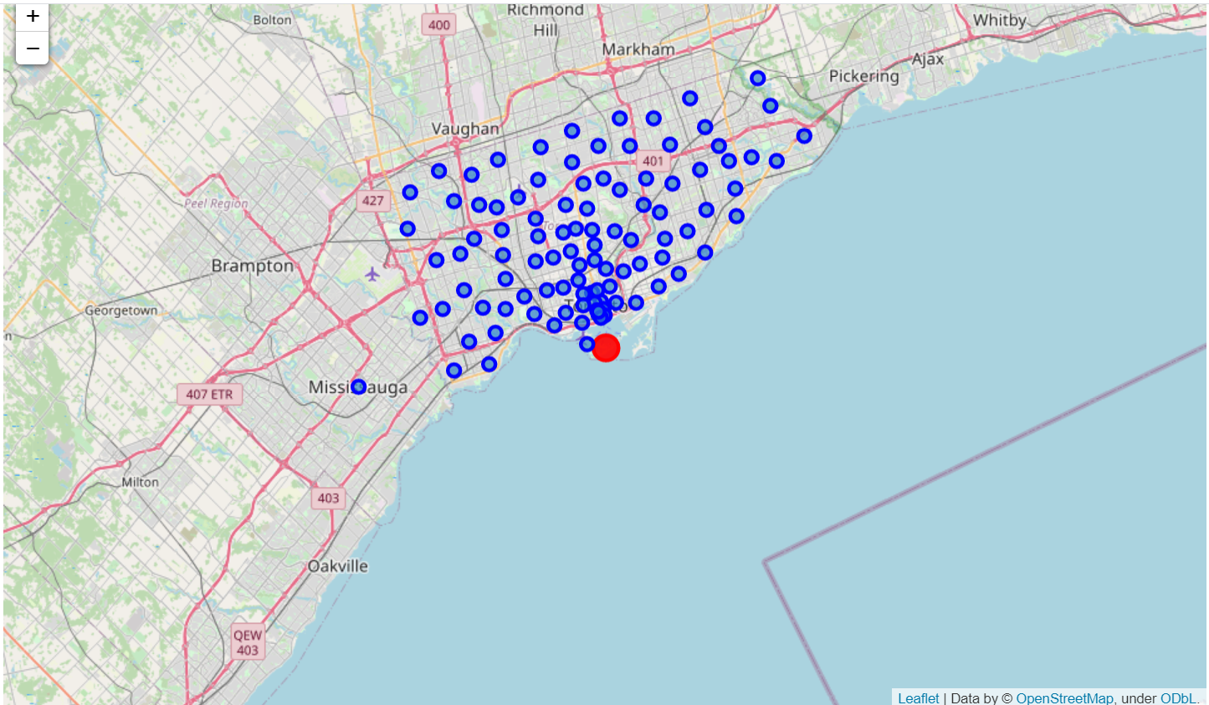
Using Folium library we displayed the scraped and preprocessed city of Toronto Neighborhoods.
Downtown Toronto is marked red; Toronto Neighborhoods spread towards the N, NE, NW of Toronto
The Northside is York, Central zone is Downtown Toronto.
These Neighborhoods emerge from 5 Boroughs: Toronto, York, Scarborough,
Etobicoke and Mississauga.

Slide 5
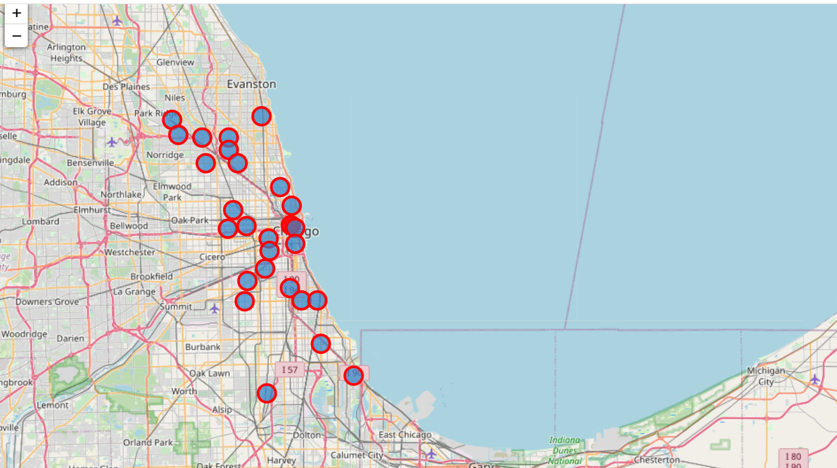
City of Chicago Neighborhoods
We scraped the following webpages and performed some kinds of data wrangling:
https://en.wikipedia.org/wiki/Community_areas_in_Chicago and https://en.wikipedia.org/wiki/List_of_neighborhoods_in_Chicago
The output is: 77 Community Areas with over 200 Neighborhoods of which The Loop is the center or the Downtown Chicago. These are the North Side, the South Side, and West Side as divided by the Chicago River

Slide 6
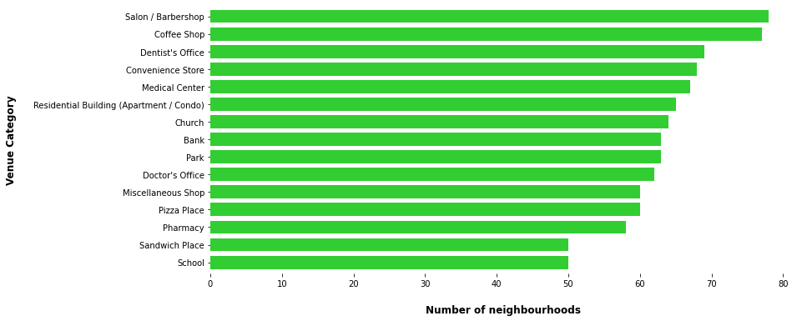
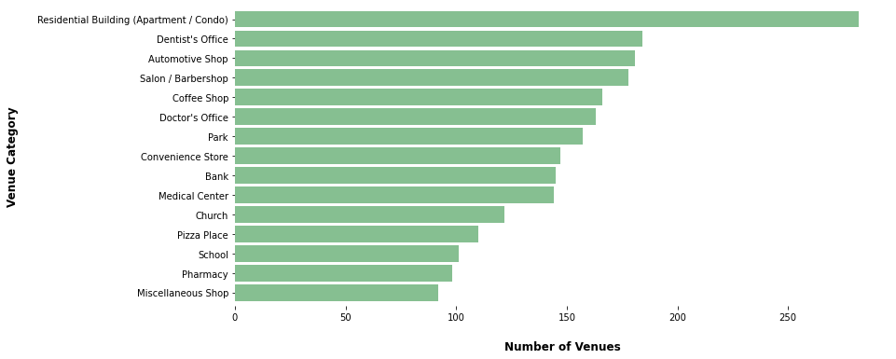
City of Toronto Venues and Venue Categories
Sending a request to Foursquare API returned some venues and venue categories

Slide 7
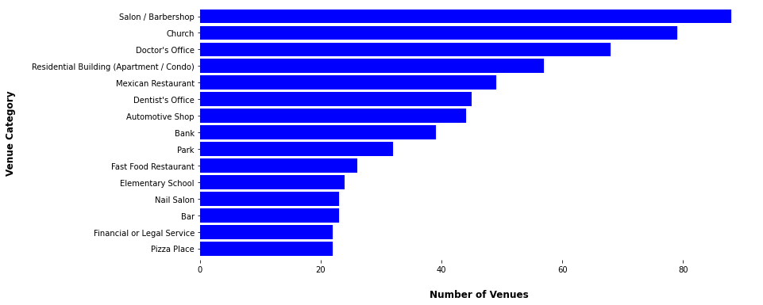
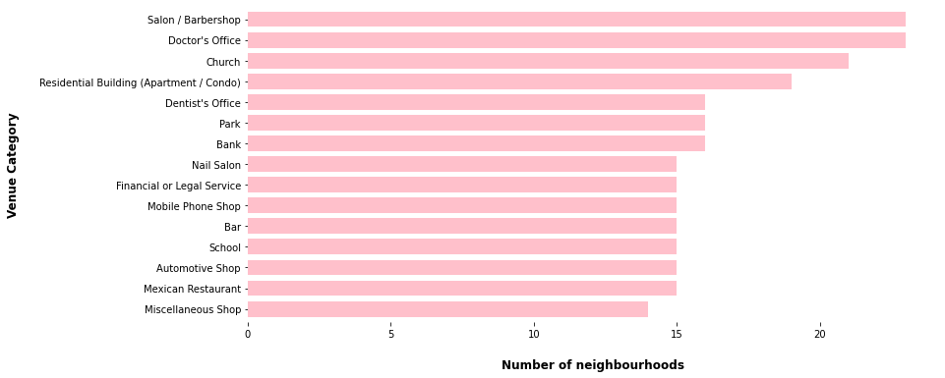
City of Chicago Venues and Venue Categories
Using Foursquare API, Venues and Venue Categories were Obtained for city of Chicago. About 331 categories were fetched.

Slide 8
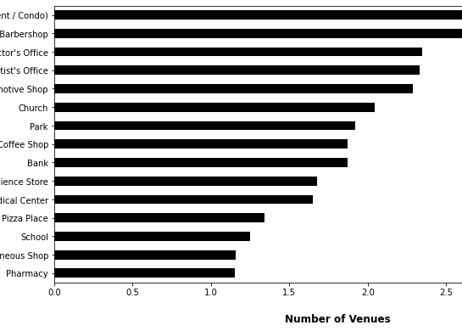
Most Common Venue Categories in both Toronto and Chicago
most common venue categories identified for both cities include Residential Building (Apartment/Condo)(35), Salon/Barbershop(27). Pharmacy and Miscellaneous shops were the least in both cities.

Slide 9
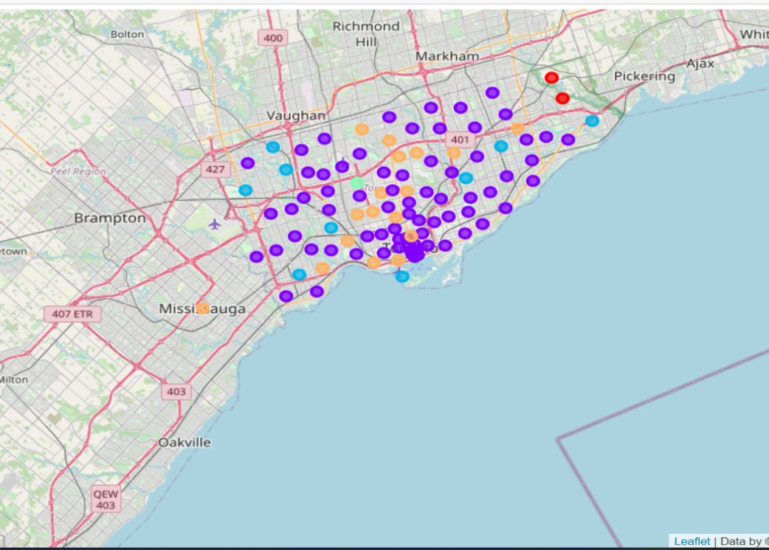
City of Toronto Neighborhood Clustering
Running the K-means clustering with setting K = 5 and combining some dataframes and Cluster Labels.
Five clusters were identified, and each classified with a certain color.
Each cluster defined the Boroughs, Neighborhoods, venues, venue categories.

Slide 10
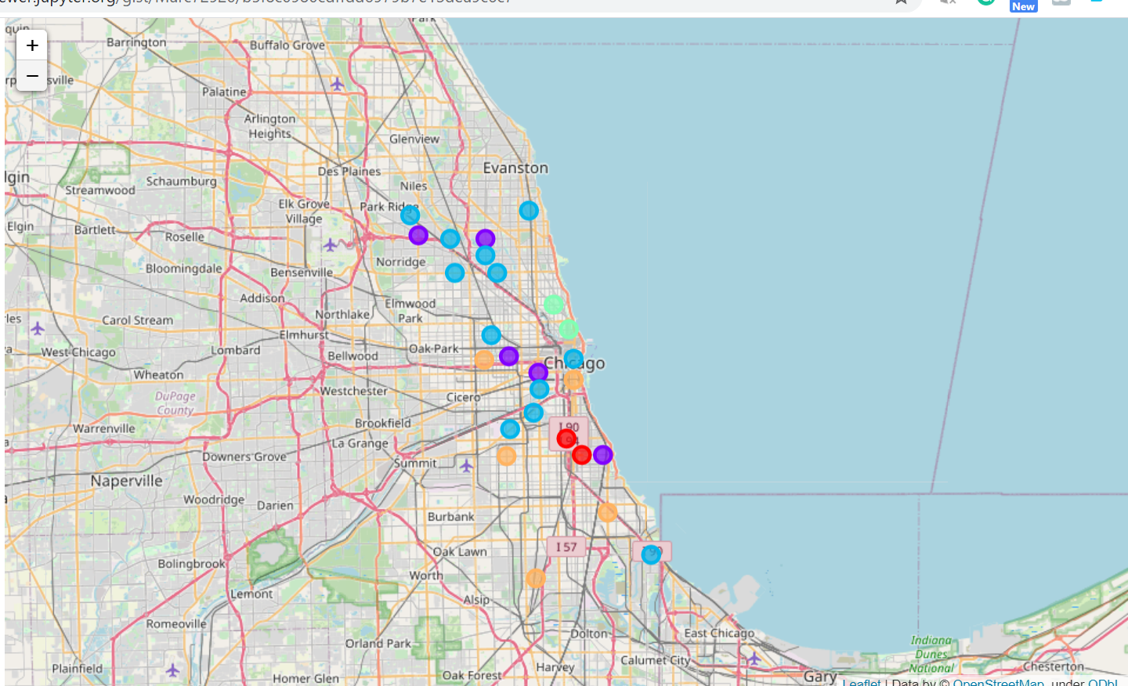
City of Chicago Neighborhood Clustering.
Similarly, we performed the same operation of K-means clustering on the dataframes with Cluster Labels.
Five Clusters were obtained, and each cluster was represented with a certain color code
In this case, each cluster determined the Community Areas, Neighborhoods, Cluster Label, Venues, venue categories.

Slide 11
Identifying the Number of Boroughs/Community Areas in each City Cluster Label.
The number of Boroughs/Community Areas in each city for the Cluster Labels indicate the clustering of Neighborhoods
The above table provides a vertical bar chart:
Toronto has the highest number except in
cluster label 1.
Cluster Labels | Toronto | Chicago
0 | 15 | 3
1 | 1 | 9
2 | 36 | 7
3 | 17 | 3
4 | 14 | 4

Slide 12
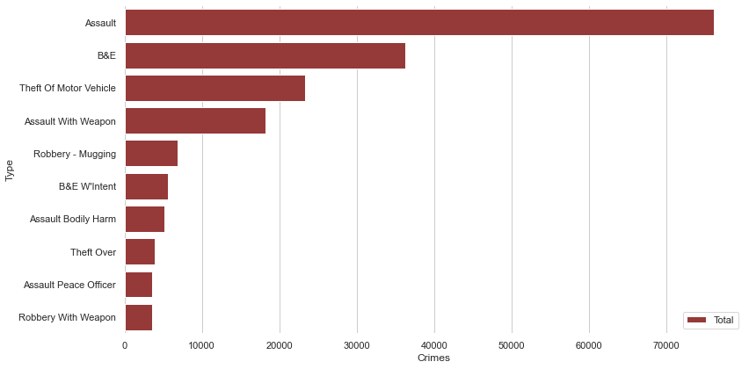
City of Toronto Crime Types and its rates
Period for this analysis is between 2014 and 2019
To articulate the number of crimes committed, we used the count method in terms of offense and premise-type.
Assault stands as the highest within this time range and Robbery with a weapon had about 3,578 as reported cases

Slide 13
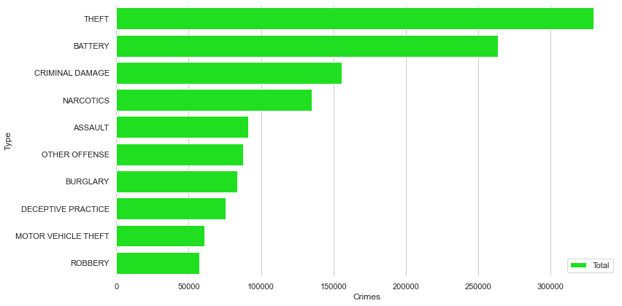
City of Chicago Crimes with Occurrence Rates
10 primary types of crimes were identified in the city of Chicago
The theft was the highest (329,460) followed by Battery and Criminal Damage (263,700 and 155,455 respectively)
Narcotics and Assault recorded 135,240 and 91,289 respectively

Slide 14
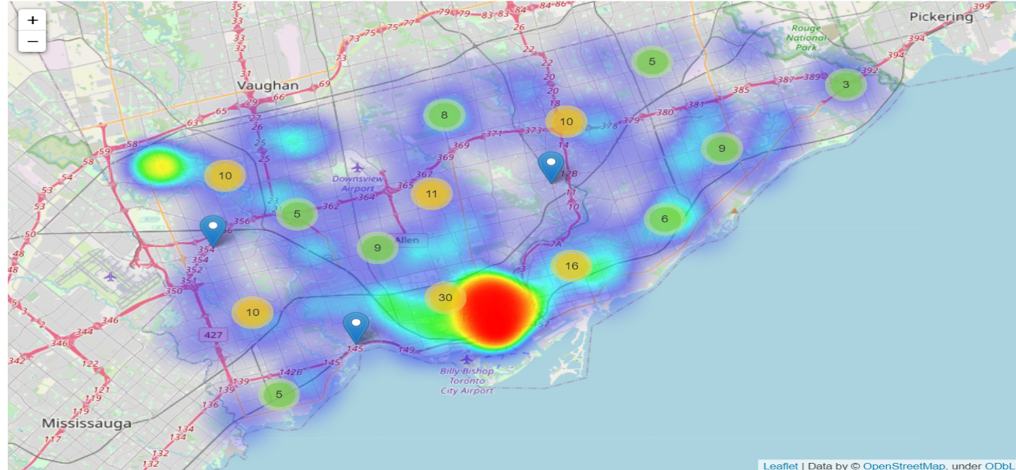
City of Toronto Neighborhoods With High Number of Crime Rates
Top number of Neighborhoods in the City of Toronto associated with crimes.
Neighborhoods where different crimes are menacingly more compare to other Neighborhoods
a high number is an indication
of the number of occurrences
in that Neighborhood.

Slide 15
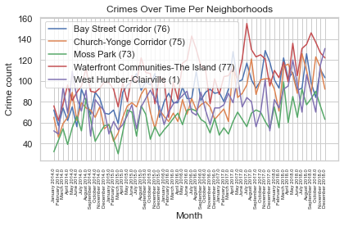
City of Toronto Crimes Committed Over Time Per Neighborhoods
The crimes overtime per neighborhood.
Waterfront Communities – The Island has the highest rate of crimes and was followed closely by the Bay Street Corridor and Church-Yonge Corridor.
Moss Park (23) has the least in terms of crimes overtime per neighborhood.

Slide 16
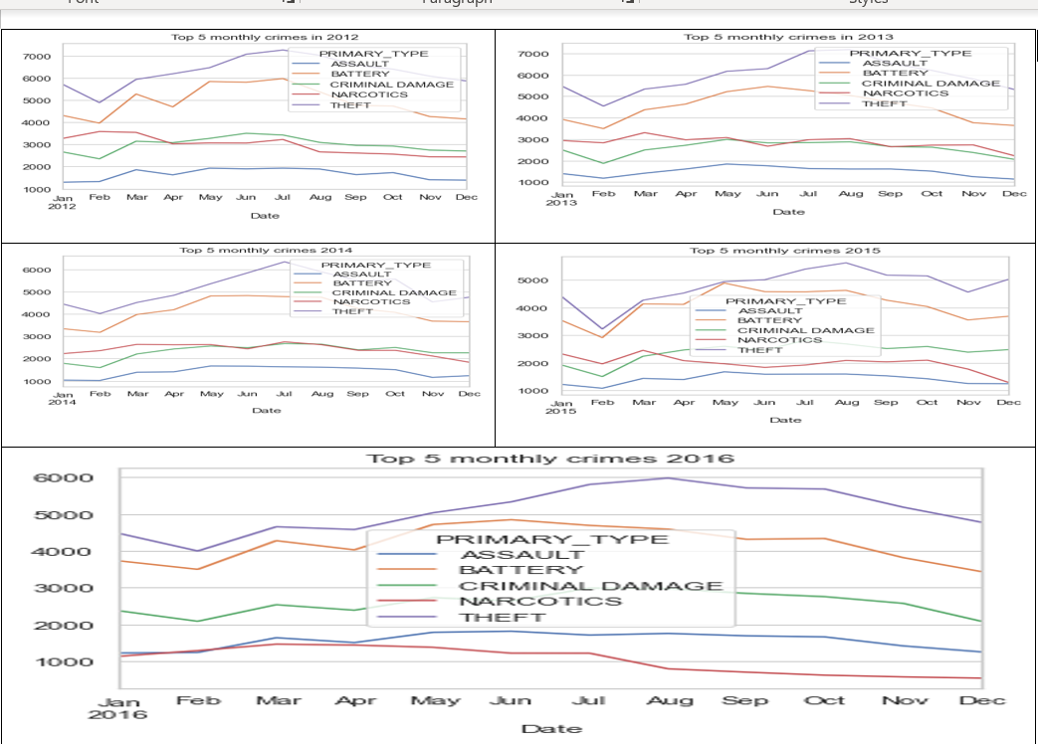
City of Chicago 5 Top Crimes trending from 2012 to 2016
5 Top Crimes trending over the past years in the city of Chicago:
Assault, Battery, Criminal Damage, Narcotics, and Theft.
Peaking between July and August every year(2012 to 2016)

Slide 17
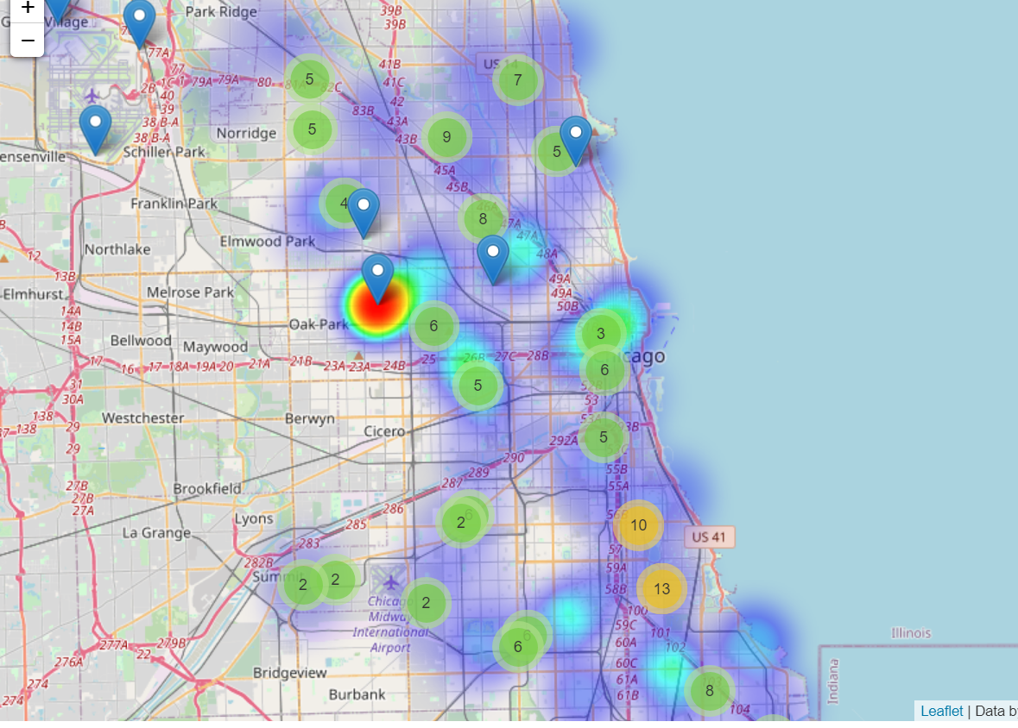
The Top Criminal Neighborhoods in the City of Chicago
Several Neighborhoods were identified to be top criminal Neighborhoods
Austin with community area number as 25 has 94,730 crime count, followed by North Lawndale(29) with 46,151, and Chatham(44) with 33,152.
Mostly Gang violence associated crimes

Slide 18
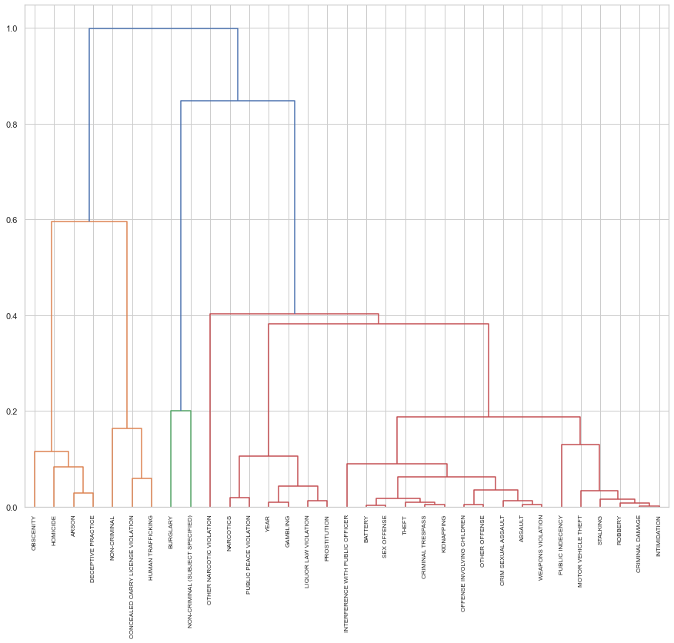
Dendrogram of the City of Chicago Crime Rate Associated with Gang Violence
Crimes associated with gang violence include homicide, concealed carry license violation, Narcotics, weapons violation within the period 2012 to 2017.
Correlation coefficient between the pairs of attributes gave the measures of the interplay between different attributes
Allows ordering the data in clusters. Threshold was 0.8

Slide 19
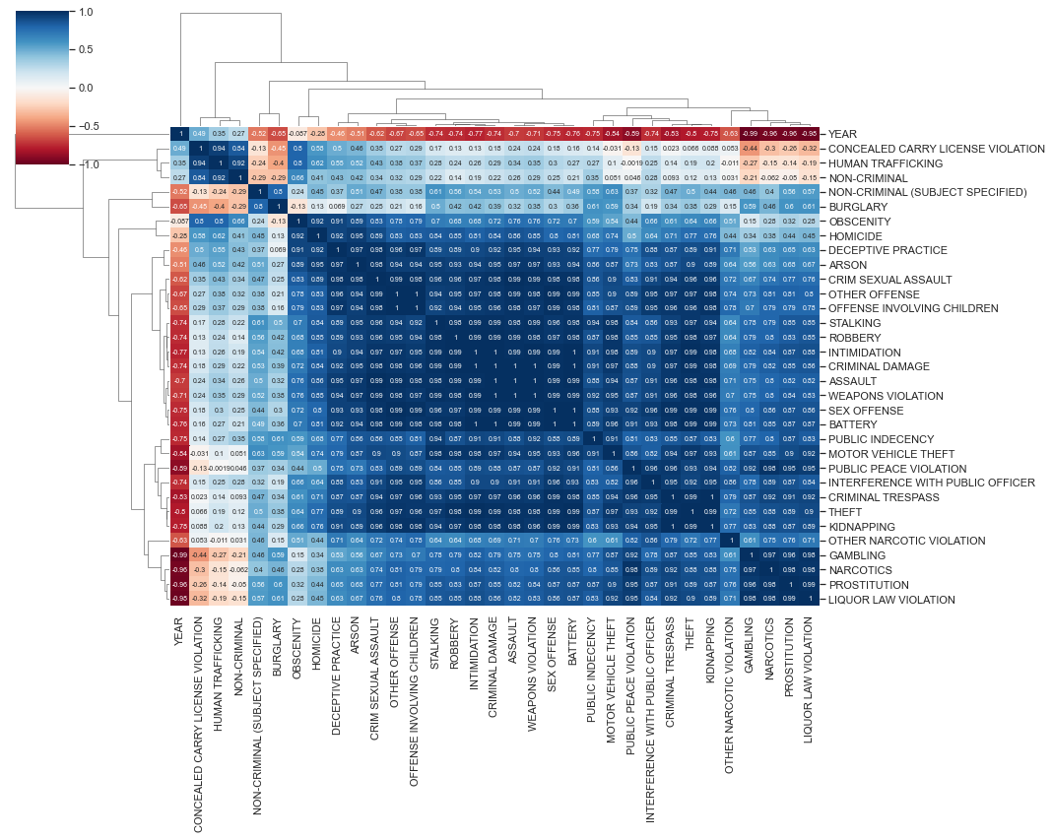
Correlation Heatmap of the City of Chicago Crime Rate Associated with Gang Violence
From the previous slide, it was possible to predict hierarchy within the data attributes
Combination of Correlation coefficient and dendrogram generate a Correlation Heatmap.
Shows the heat patterns, the correlation coefficient, and the hierarchical ordering within the features.
Deep blue and blue colors indicate how related these attributes were.

Slide 20
Conclusion and possible recommendations
Showed venues, venue categories and Neighborhood clustering for both cities
Results demonstrated that crime rates in the city of Chicago outclass those of city of Toronto
City of Toronto indicates a good haven for both individuals and corporate bodies to operate.
Recommendations include:
Using Machine Learning to update and simulate the cities for
developers
Adopt system that enable prediction of crime rates in these cities.

